Slide 1


Xccelerate.co
Data Science - Power BI Part II

Slide 2


DAXplosion: Unleashing the Power of DAX in Power BI
Notes:
https://forms.gle/jnob3YLb33f7Zxcw5 - Feedback form

Slide 3
Introduction to DAX in Power BI
DAX (Data Analysis Expressions) is a formula language used in Power BI to create custom calculations and aggregations on data. It allows users to perform complex calculations and analysis that are not possible with simple aggregation functions.
DAX is based on Excel formulas and syntax, making it easy for Excel users to transition to Power BI. However, it has additional functions and capabilities that are specific to Power BI and other data modeling tools.
Notes:
https://forms.gle/jnob3YLb33f7Zxcw5 - Feedback form

Slide 4
Understanding DAX Functions
DAX functions can be categorized into several types: aggregation functions, time intelligence functions, filtering functions, text functions, and more. Each type of function serves a specific purpose and can be combined to create complex calculations.
Aggregation functions, such as SUM and AVERAGE, calculate values based on a set of rows or columns. Time intelligence functions, such as SAMEPERIODLASTYEAR and TOTALYTD, allow users to analyze data over time periods. Filtering functions, such as CALCULATE and FILTER, modify the context of calculations based on specific filters or conditions.
Notes:
https://forms.gle/jnob3YLb33f7Zxcw5 - Feedback form

Slide 5
Let’s create a New Measure
Notes:
https://forms.gle/jnob3YLb33f7Zxcw5 - Feedback form

Slide 6
But what is a measure?
It is simply a calculation on our data, that will be visualized.
Notes:
https://forms.gle/jnob3YLb33f7Zxcw5 - Feedback form

Slide 7
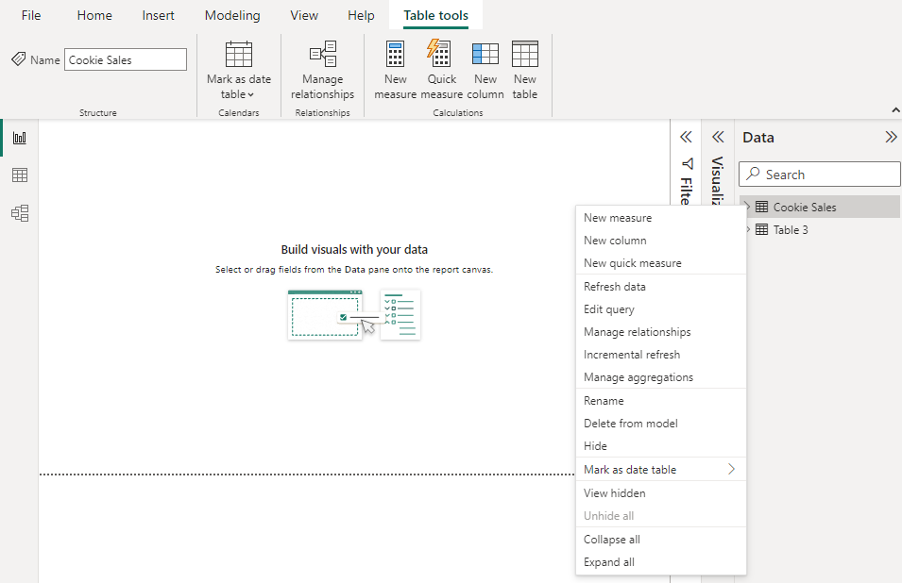
Let’s assume we want to know how many total Cookies were sold?
1
Right Click here and select ‘New Measure’
2

Slide 8
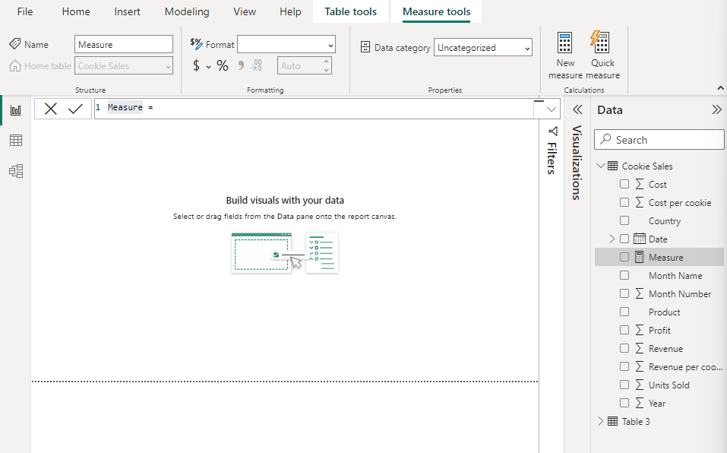
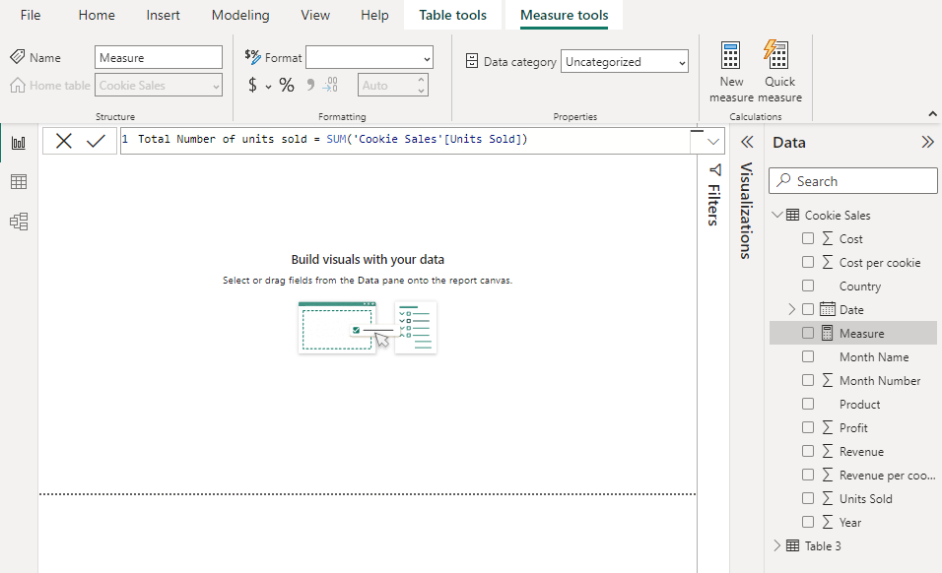
Let’s assume we want to know how many total Cookies were sold?
2
Change the Measure to our intended calculation

Slide 9
Congratulations, you have created a new Measure!
Notes:
https://forms.gle/jnob3YLb33f7Zxcw5 - Feedback form

Slide 10
Calculated Column?
Notes:
https://forms.gle/jnob3YLb33f7Zxcw5 - Feedback form

Slide 11
Let’s assume we want to know how much profit did we make for each sale?
1
Right Click here and select ‘New Column’
2

Slide 12
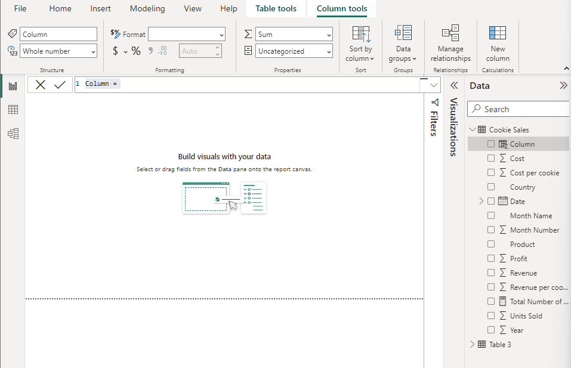
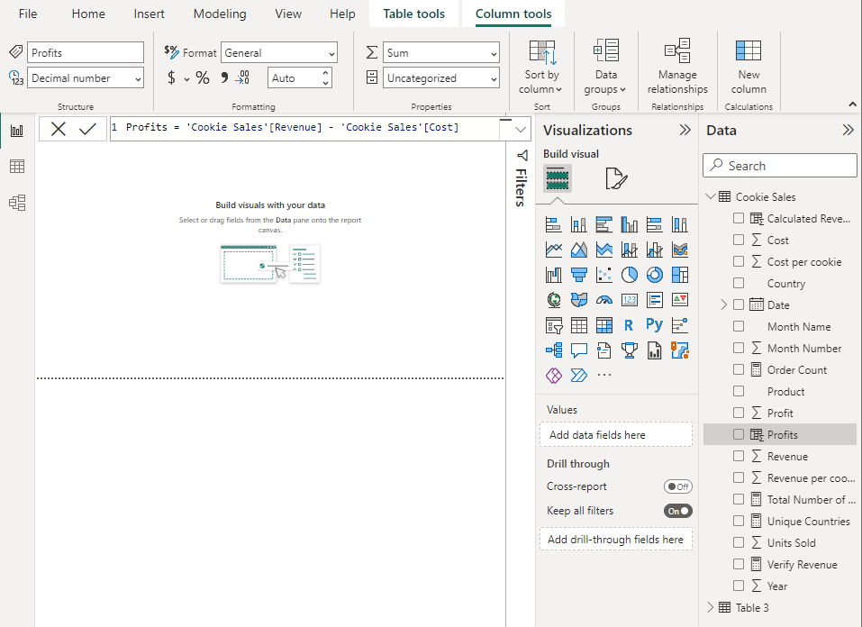
Let’s assume we want to know how many total Cookies were sold?
2
Change the Column to our intended calculation

Slide 13
Let’s assume we want to know how many total Cookies were sold?
3
Press the check mark!

Slide 14
Congratulations, you have created a new calculated Column!
Notes:
https://forms.gle/jnob3YLb33f7Zxcw5 - Feedback form

Slide 15
What’s the difference?
A Measure is an aggregation of all data in the table.
Whereas, a column is a combination of several column values from the same row and applied across all the rows.
Notes:
https://forms.gle/jnob3YLb33f7Zxcw5 - Feedback form

Slide 16
Please create the following Measures:
[You might have to create new columns]
Notes:
https://forms.gle/jnob3YLb33f7Zxcw5 - Feedback form

Slide 17
Verify Revenue: sum(units sold * Revenue per Cookie) - sum(Revenue) [Should be 0]
Count the number of rows [Use function COUNT()]
Count the number of unique countries [Use DISTINCTCOUNT()]
Notes:
https://forms.gle/jnob3YLb33f7Zxcw5 - Feedback form

Slide 18
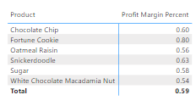
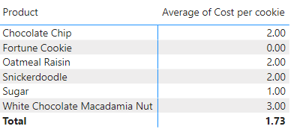
Create elements that looks like below:
1
2

Slide 19
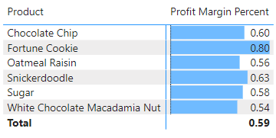
Create elements that looks like below:
1

Slide 20
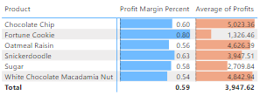
Create elements that looks like below:
1

Slide 21
Iterators in Power BI

Slide 22
Suppose you want to create a Measure which calculates the Profits by (units sold) * (Revenue per cookie - Cost per cookie)
Create a new measure.
Write the following:
SUMX() goes through each row and computes the value. You can find other operations with an ‘X’ ending, which have similar behaviour

Slide 23
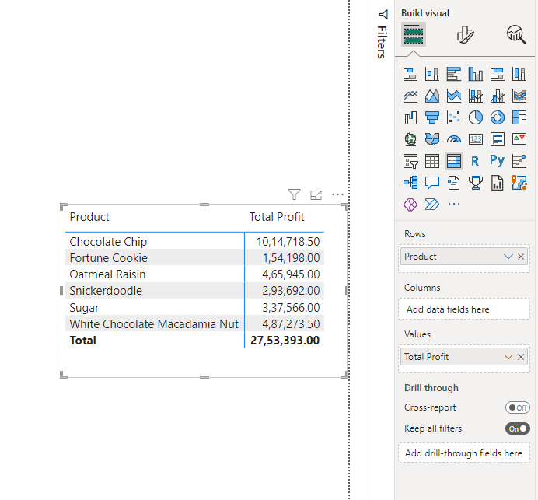
Create a matrix element using the Total Profit and Product to create a visualization like this
1
2
3

Slide 24
Can you create an iterative measure called Profit per cookie which calculates Revenue per cookie - Cost per cookier

Slide 25
Let’s do some date operations

Slide 26
Let’s see which days are best selling days
You have access to many date functions, we will see one of them now.
Create a new measure called Day of week with the given definition. Here ‘1’ in the second argument represents Sunday = 1, and Saturday = 7

Slide 27
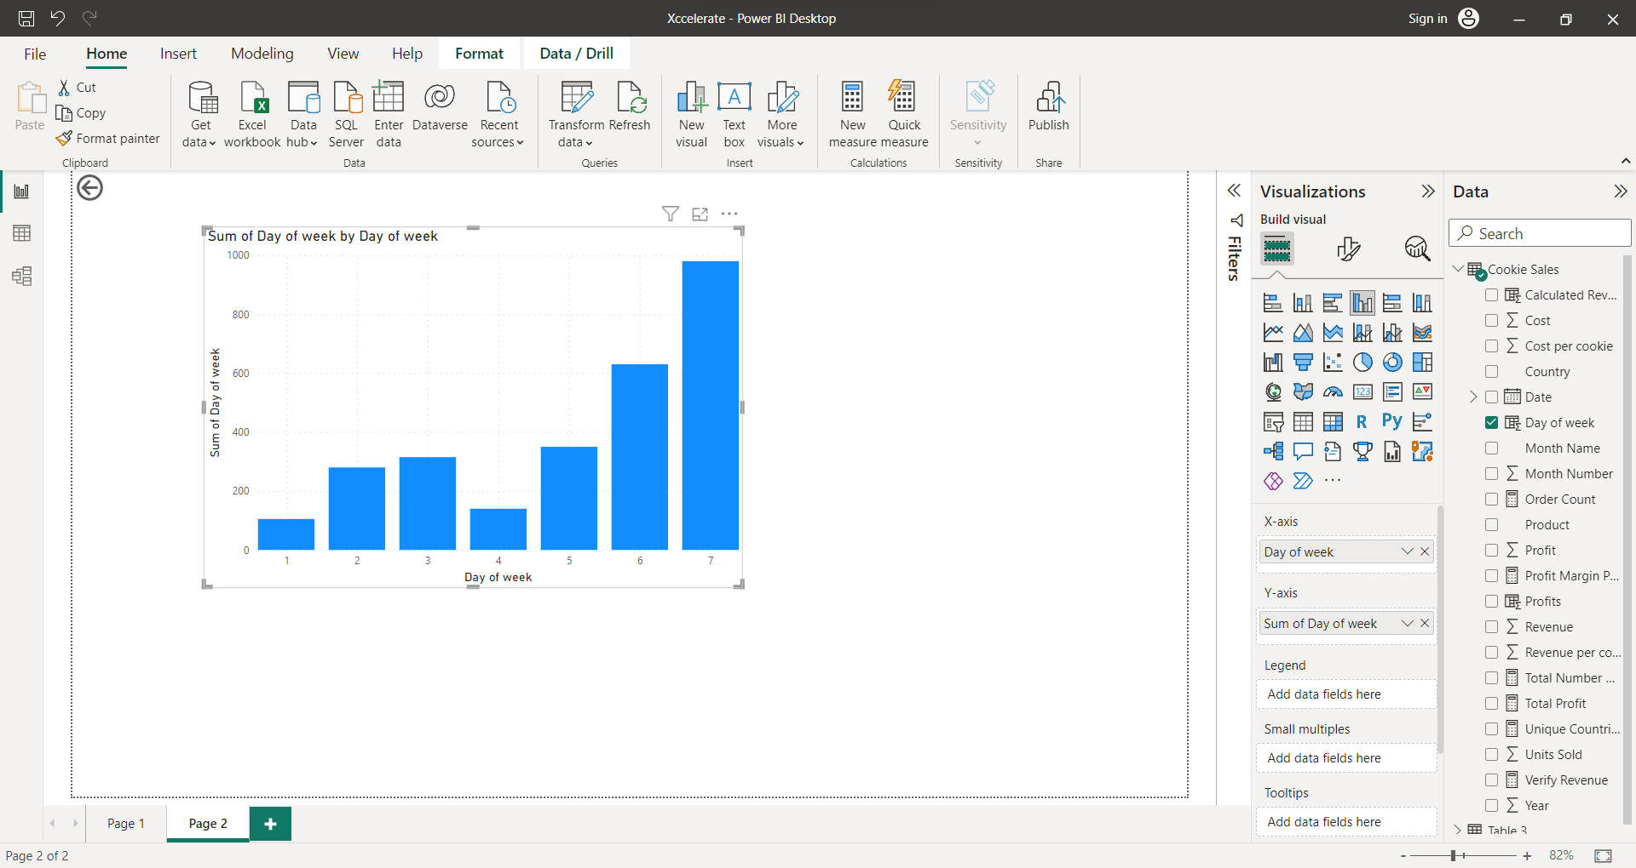
Once you have the measure-
1
2

Slide 28
We see how the sales increase on Thursday, Friday and Saturday and resets on Sunday. This is helpful information, because now we can focus on why the sales are bad early in the week.

Slide 29
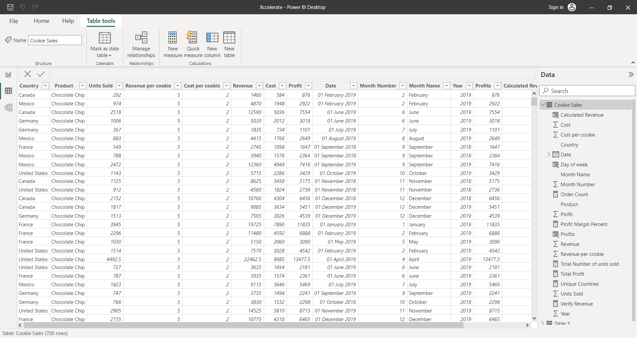
Let try to find patterns in our data
Let’s try to find the products which have ‘Chocolate’ in their name.
Let’s switch to the data view

Slide 30
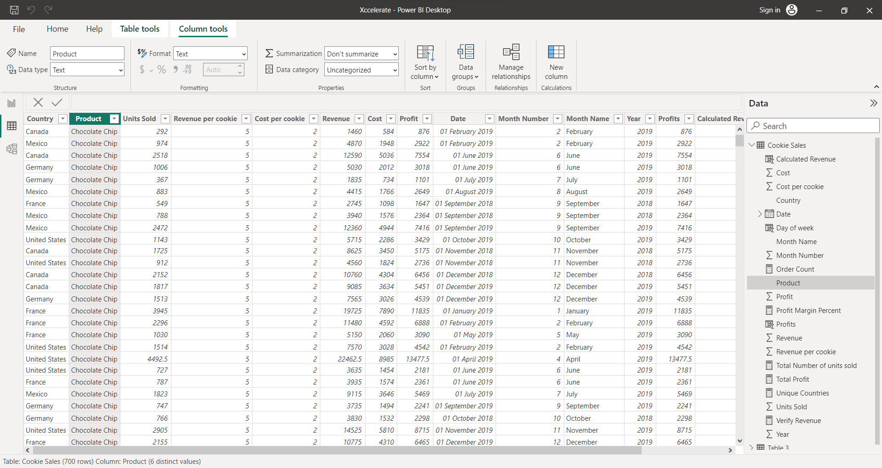
1
2
Insert a new column

Slide 31
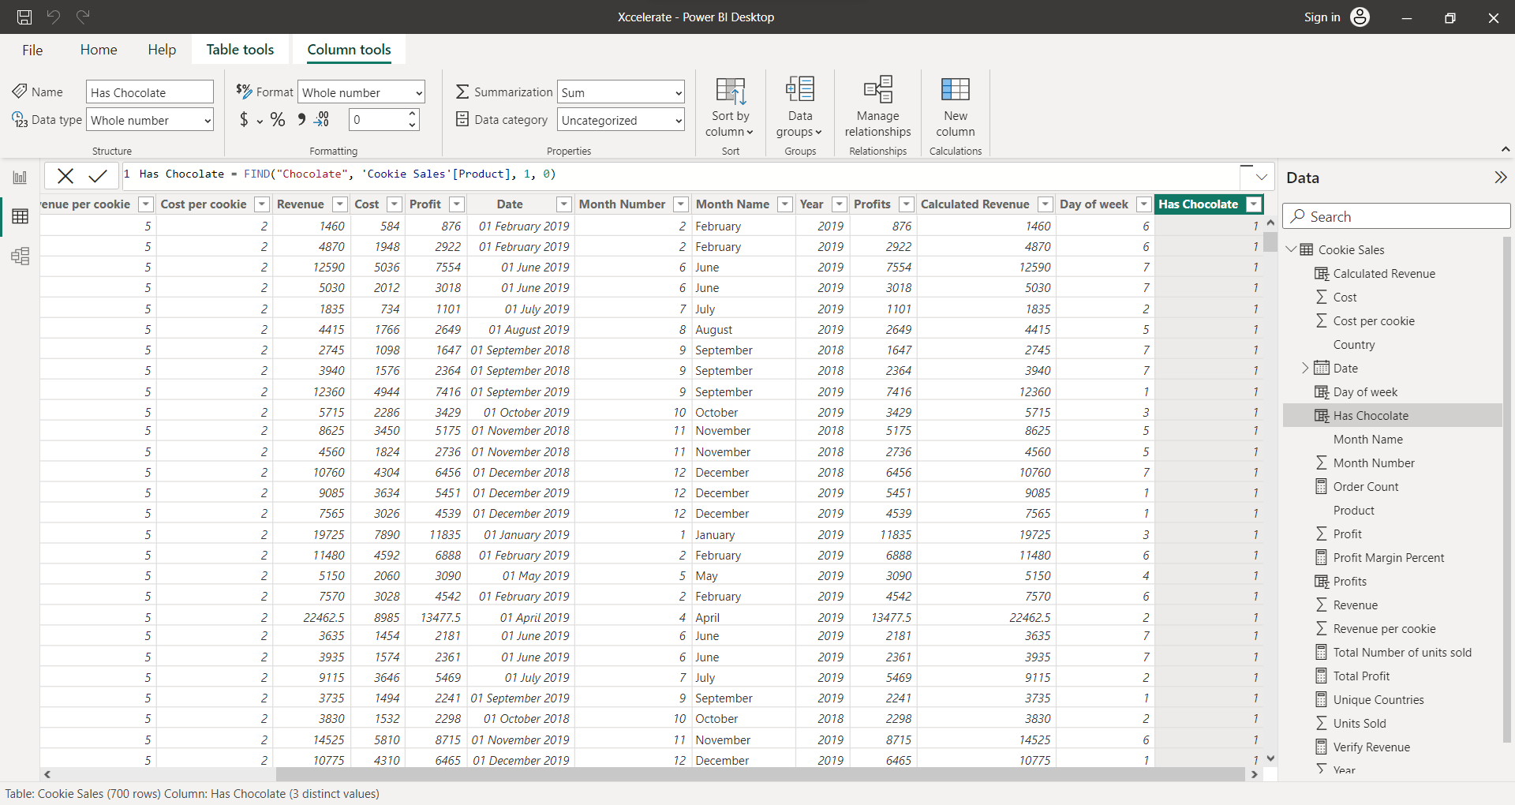
3

Slide 32
Let’s go through the column we just created and try to understand it better. As we keep going down the column, we can see ‘Chocolate chip’ has chocolate in position 1, ‘Oatmeal Raisin’ doesn’t have chocolate in it, and ‘White Chocolate macadamia nut’ has chocolate in position 7, and so on. Basically, whenever we have a value greater than 0, we have chocolate.

Slide 33
Let’s change the column
We will change the column and include an if statement to condition on our existing ‘Has Chocolate’ field to return a true or false.

Slide 34
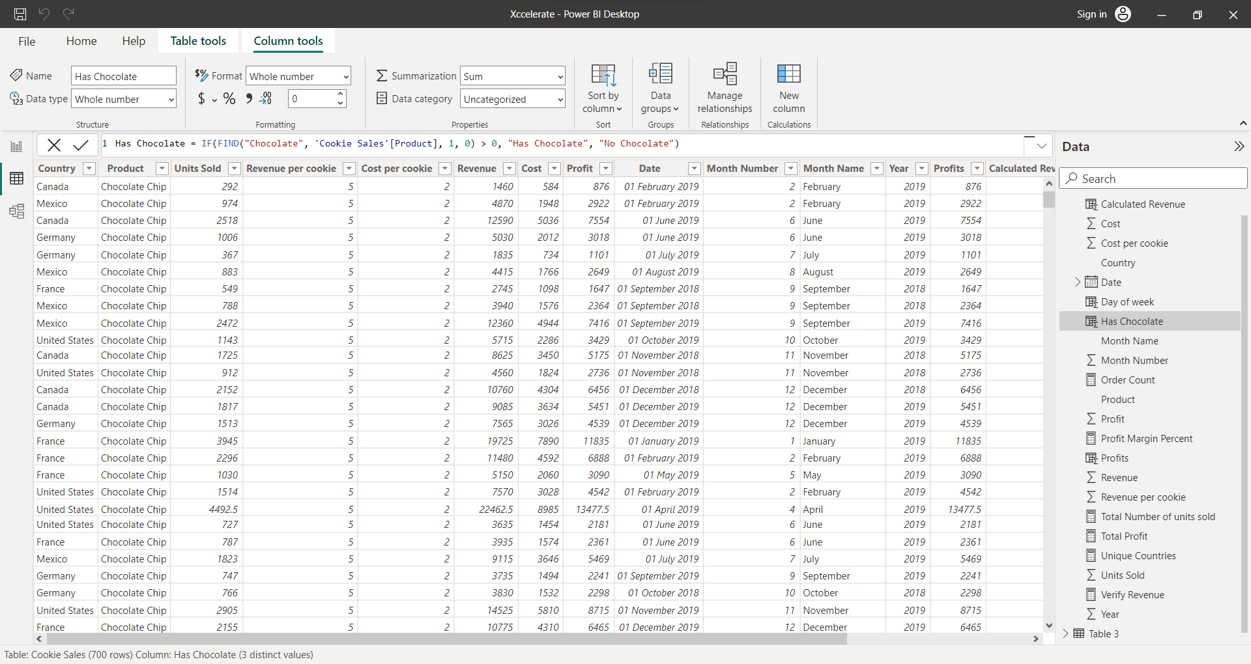
2
Make the necessary changes
Select the column if not selected already
1
Once applied, we can see the changes.

Slide 35
Finally we will look at calculated functions
Suppose we want to know how many orders of Chocolate Chip cookies had over 500 units? Sounds complicated, right?
Let’s solve this problem.

Slide 36
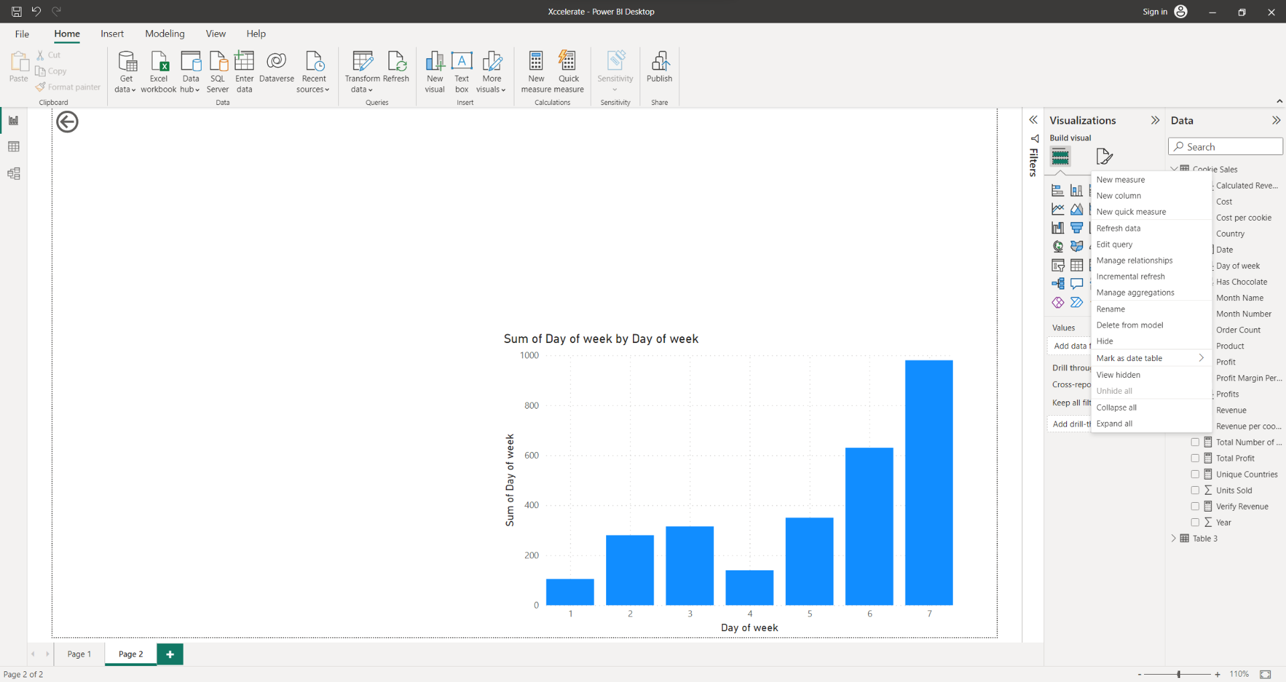
By now you should have an understanding of what we are going to do. Create a new measure with this definition.
It’s pretty self explanatory, we are counting rows in table ‘Cookie Sales’ and our filters are where units sold is greater than 500 and product name is Chocolate Chip.

Slide 37
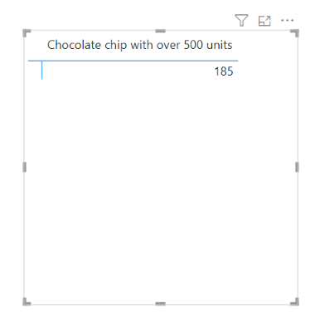
We can now visualise this
And now you know how to use DAX and Power query in Power BI.

Slide 38
Conclusion: Harnessing the Power of DAX in Power BI
DAX is a powerful formula language that allows users to perform complex calculations and analysis in Power BI. It is essential for data modeling and can be used to create custom measures, tables, and visualizations.
By following best practices and optimizing DAX performance, users can harness the full power of DAX and create insightful and impactful reports in Power BI.

